Slide 1


Bank Account Ledger
Rahkim H. Coleman
COS-112-001
Dr. Dali

Slide 2

So, what is a Bank Ledger? What does it include?
A bank's ledger is a record of all account activity: deposits, withdrawals, and other transactions, all listed in order. Individuals and businesses use it to keep track of money coming in and going out.
For this program, the ledger tracks deposits and withdrawals, reads transactions from an input file, and generates detailed account reports.

Slide 3
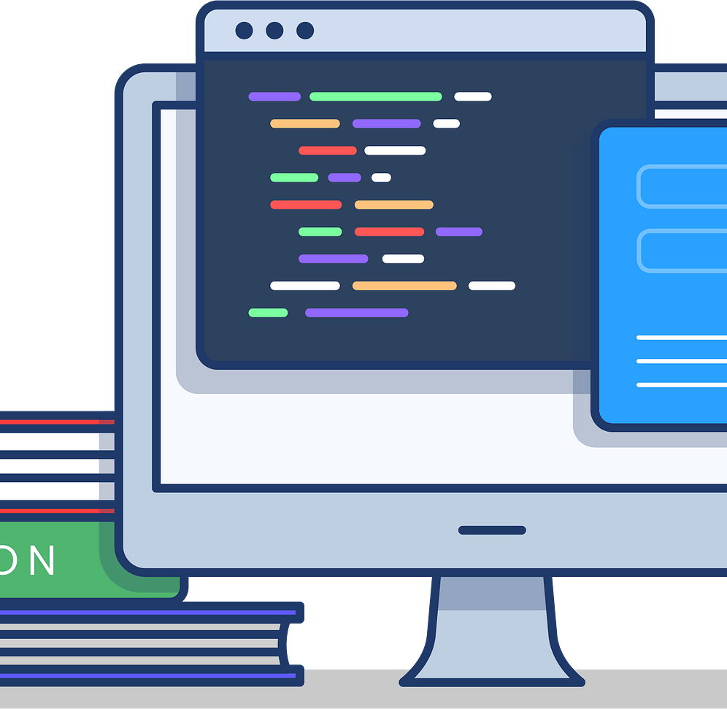
Alright, so how does this program work?
Loading the accounts themselves: This reads bankdata.txt to create other accounts with starting balances.
Process Transactions: Updates accounts based on transaction type: D= Deposit, W= Withdrawal. Invalid transactions are logged instead of applied.
Generate Report: Creates a text file showing each account’s final balance and full transaction history.
Optional Auto-Open: Opens the report automatically if supported by the system.

Slide 4

Challenges Solved: What Problems Did I Face?
Finding the Input File: At first, I got a FileNotFoundException because bankdata.txt wasn’t in the right place. I solved it by checking the project root and adding an error message to guide the user.
Handling Invalid Transactions: I realized users could try negative deposits, withdrawals over the balance, or invalid transaction codes. I fixed this by logging these issues instead of letting the program crash.
Formatting the Report: I made the transaction report clear and organized, showing each transaction and final balance.

Slide 5
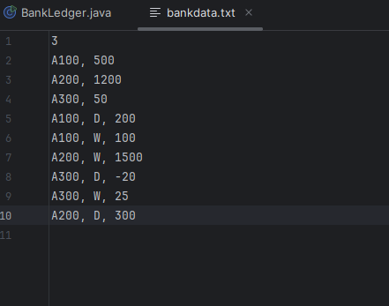
Example of Input File or bankdata.txt
The first line, which is 3, signals the number of accounts in this file. In this scenario, we have 3 accounts.
The lines after that define each account and its early balance: A100 with $500, A200 with $1200, and A300 with $50.
A100: I deposited $200 into account A100, which increased the balance from $500 to $700. I then withdrew $100 from A100, reducing the balance to $600.
A200: I tried to withdraw $1500 from A200, but the account only had $1200, so the withdrawal was denied to prevent an overdraft. I then decided to deposit $300 into A200, and this time it worked, increasing the balance to $1500.
A300: I tried to deposit a negative amount (-20) into A300, which is invalid, so the transaction was ignored. I then withdrew $25 from A300, leaving a new balance of $25.

Slide 6
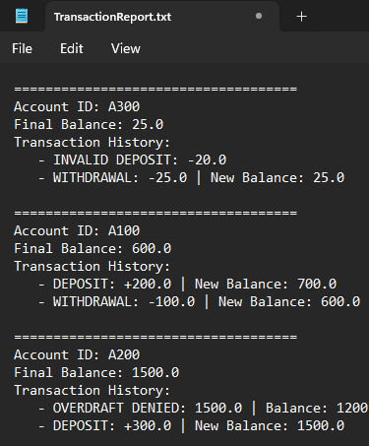
Example of Output Report (TransactionReport.txt)
When I ran the program in IntelliJ, it automatically generated this report and opened it in Notepad.
Each account shows its final balance and a full transaction history, including invalid deposits or denied withdrawals.
This helps make the results easy to read without having to scramble through the console.

Slide 7
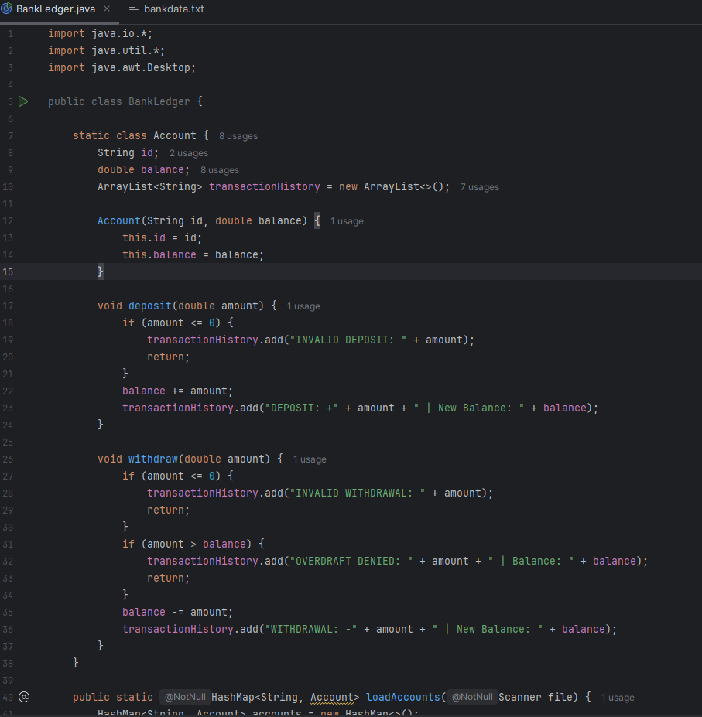
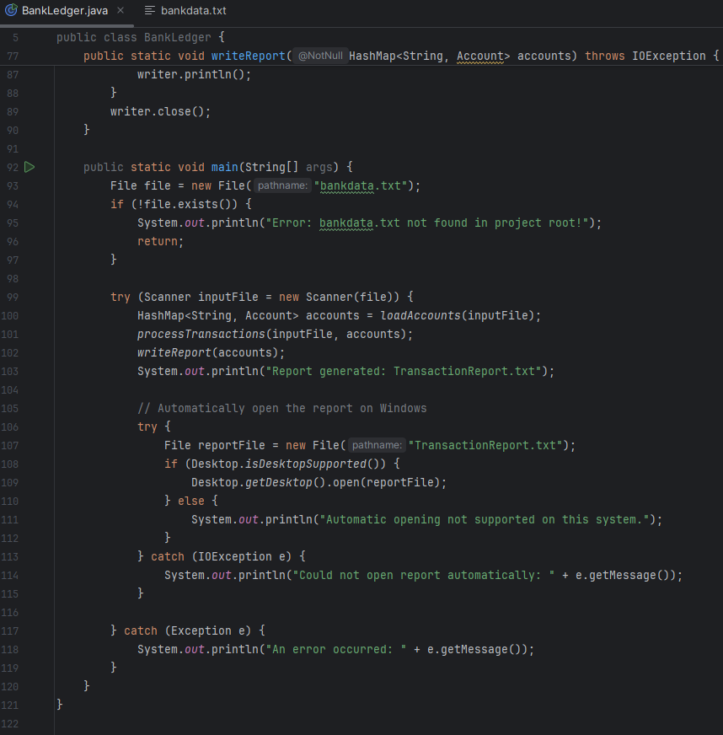
Photo Gallery of IntelliJ Console

Slide 8

What is the Console Showing?
That was the main Java code that controls how the bank ledger program works.
First, it checks whether bankdata.txt exists so the program doesn’t crash if the file is missing. Then, it uses the loadAccounts() method to read each account’s starting balance from the file. After that, the processTransactions() method goes through every deposit or withdrawal and updates each account correctly, including invalid or denied transactions.
The program then calls writeReport() to create TransactionReport.txt, which includes every account’s final balance and full transaction history.
Finally, the code tells Windows to automatically open the finished report in Notepad, so the results appear instantly after the program runs.

Slide 9

Conclusion
Overall, this project made it easier for me to figure out how each aspect of the program functions. From reading input to updating balances, I saw how small pieces of logic create a full, working system.
I learned the most from the debugging process. I had to slow down, test thoroughly, and determine exactly what the program was doing whenever something didn't behave as I had anticipated.
Ultimately, the project increased my optimism in using the ideas we did in class. Running the program and seeing real-time results made everything feel more connected and understandable.

